Slide 1
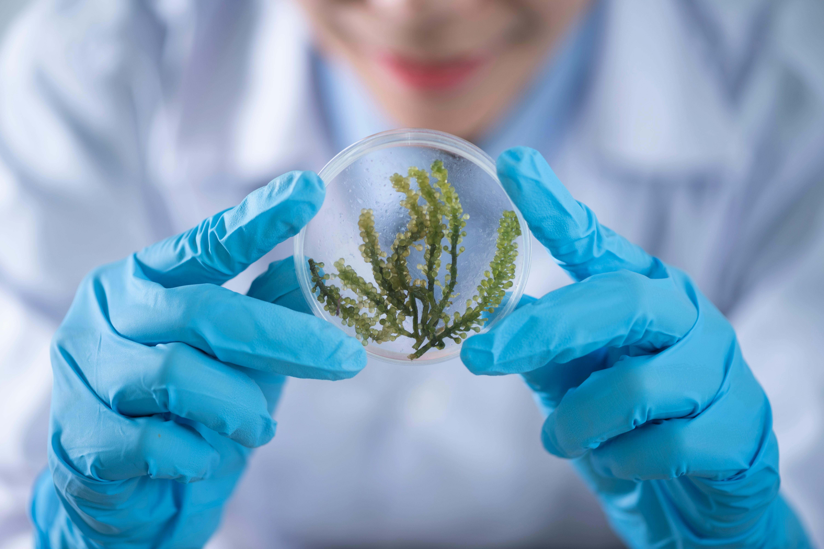
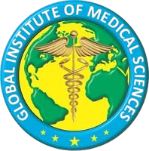
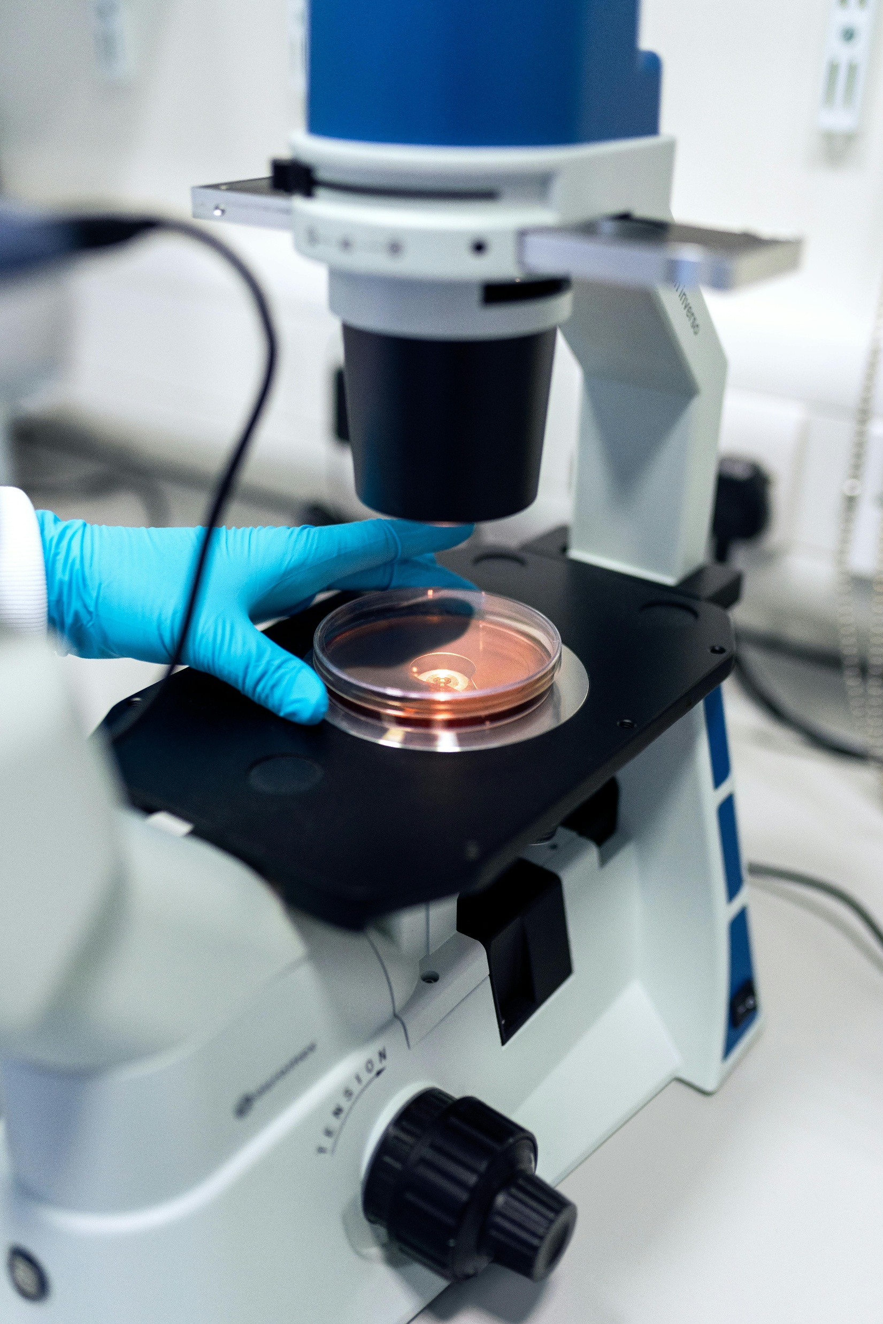
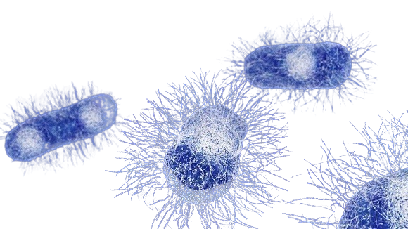
Course Discerption
BS NURSING (Year I Semester I) Subject : Microbiology
By
Zull e Nourain
Lecturer
Global Institute of Medical Sciences-GIMS

Slide 2

Course Description
This course is designed to furnish the learner with the knowledge of basic concepts and scientific principles of microbiology.
It facilitate the learner to learn the application and principle of microbiology in hospital and community environments.

Slide 3
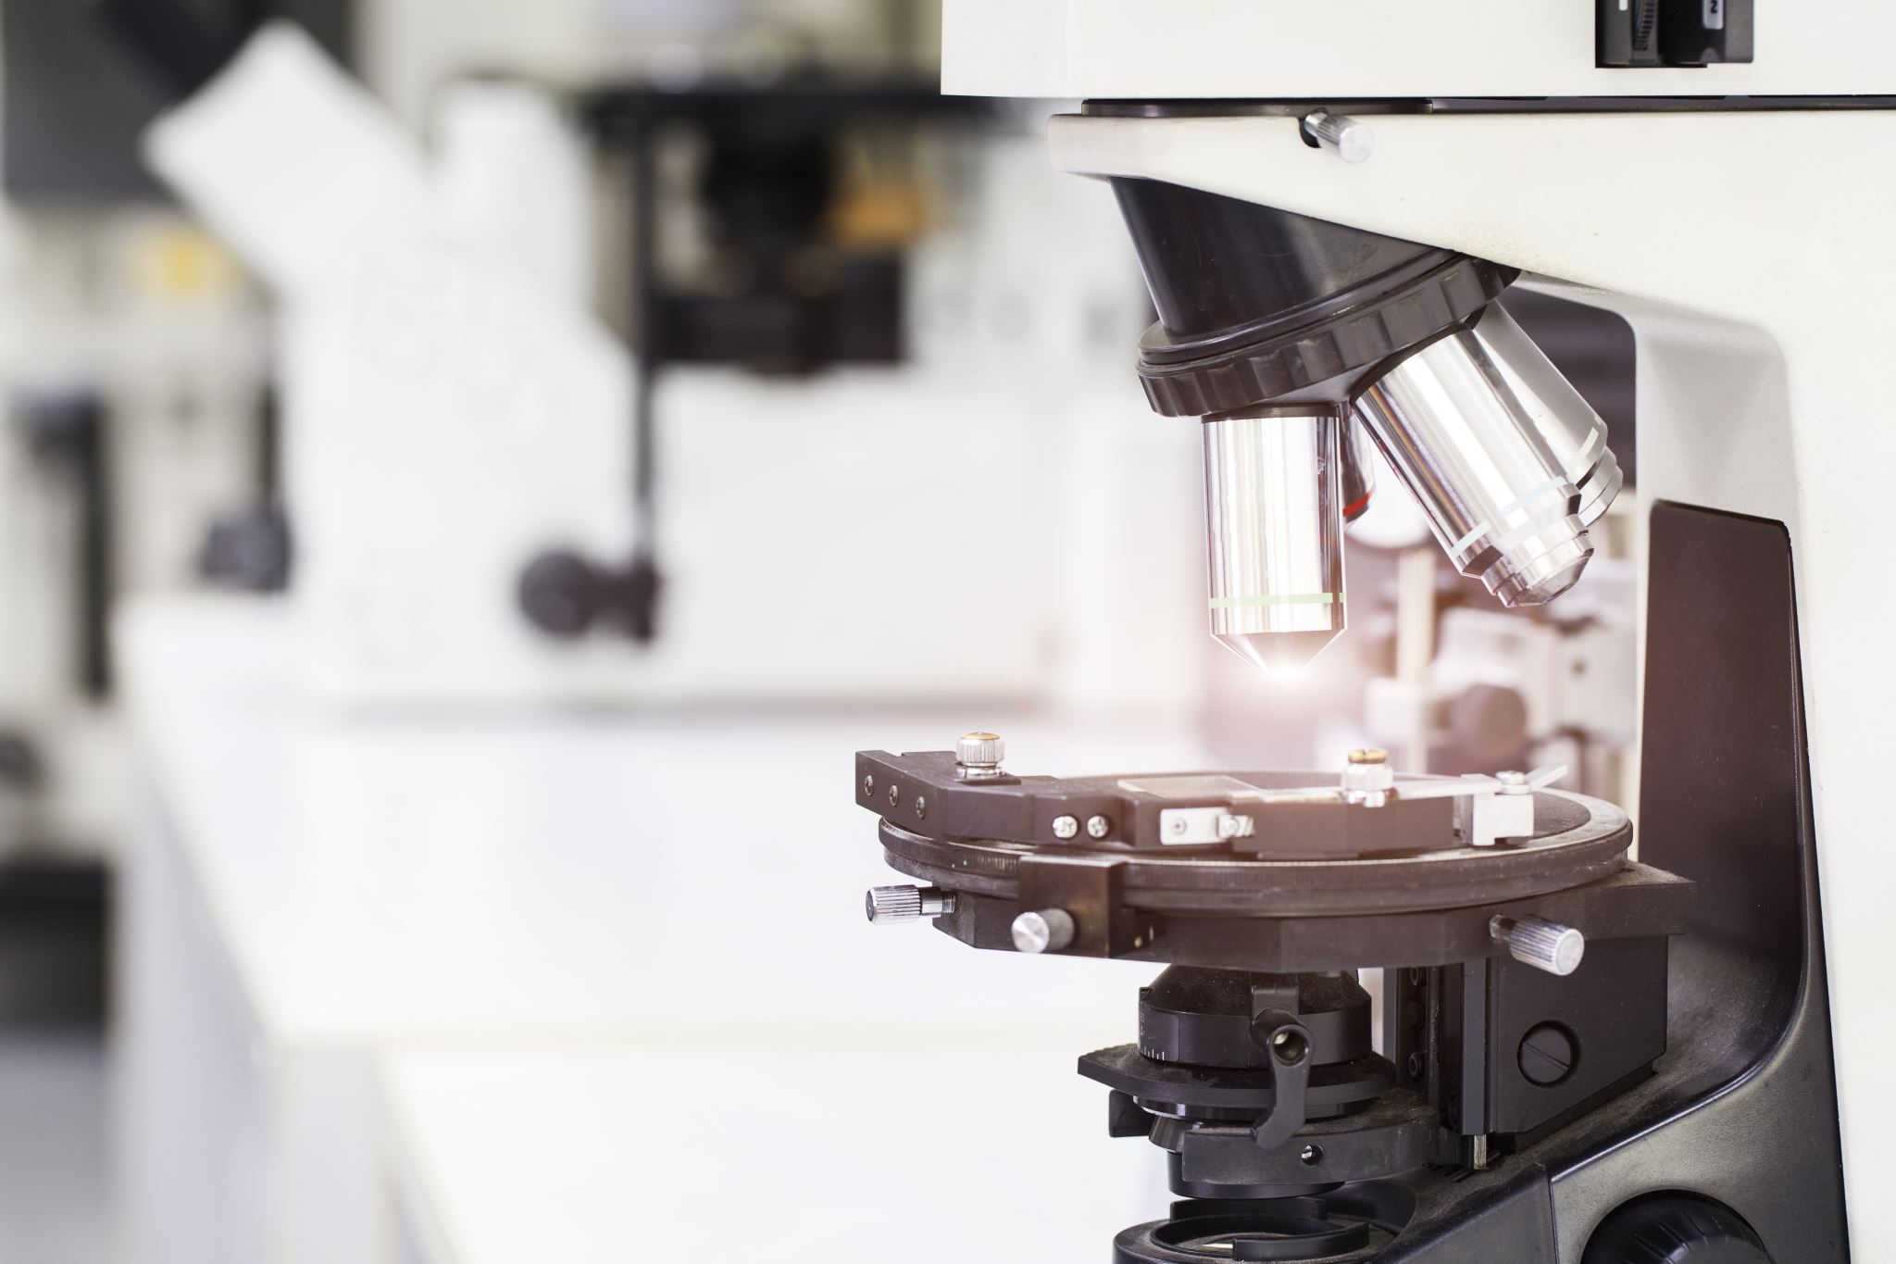
Course Outline
Unit No 01 Introduction to Microbiology
Unit No 02 Control of Microorganism
Unit No 03 Defense Mechanism of The Body
Unit No 04 Medical and Surgical Asepsis
Unit No 05 Concept of Isolation
Unit No 06 Human and Microbial Interaction
Unit No 07 Microbiology in Everyday Life
Unit No 08 Safe Use of Microscope in Lab
Unit No 9 Staining of Bacteria

Slide 4
Skill Domain
Demonstrate and make use of operating a microscope.
Demonstrate the safe handling of chemical and equipment's in Lab.
Perform the procedure to prepare slide of culture media.
Demonstrate the preventive measure during various type of isolation.
Demonstrate preventive measure to control nosocomial infection in patients.
Perform the procedure of staining Microorganisms

Slide 5
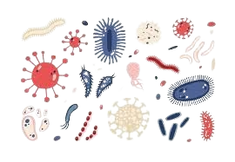
Unit No # 1
Introduction to Microbiology
By
Zull e Nourain
Global Institute of Medical Sciences-GIMS

Slide 6
Learning Goals
By the completion of this unit learners will be able to:
Define microbiology, Also Discuss sub discipline of microbiology
Importance of microbiology in nursing practice
History and Contribution of microbiology
(Scientist name) Antonie van Leeuwenhoek, Francesco Redi Louis Pasteur ,Robert Koch Eukaryotic vs. Prokaryotic cell
Classification of Bacteria based on nutritional requirement and morphology.
Basic nutritional requirements of microorganisms.
Basic properties of Virus.

Slide 7
INTRODUTION MICROBIOLOGY
The term Microbiology derives its name from three Greek words micro [small] bios [life] and logos [study].
Microbiology is the science that deals with the study of microorganisms.
Microbiology is the study of those microscopic organisms and agents that are too small that cannot be seen with naked eye.
Microorganisms are present everywhere on earth, including human beings, animals, plants, soil, water, food and atmosphere
Microorganisms may be beneficial or harmful to human beings.

Slide 8
Sub Disciplines of Microbiology
Bacteriology: The study of bacteria
Virology: The study of virus
Protozoology: The study of protozoa
Immunology: The study of immunity
Mycology: The study of fungi
Phycology: The study of algae
Parasitology The study of parasite

Slide 9
Milestones
Father of Modern Microbiology: Louis Pasteur
Father of Biology : Aristotle
Father of Antiseptics: Joseph Lister
Father of Cytology: Robert Hooke
Father of modern Bacteriology: Robert Koch
Father of microscope:Antonie van Leeuwenhoek
Father of virology:Martinus Willem Beijerink
Father of Vaccination / Immunology: Edward Janner

Slide 10
Terminology Related to microbiology
Pathogen: An organism which causes disease is called pathogen.
Parasite: An organism that lives in or on another species or creature and obtains food and shelter without benefiting but rather harming the host.
Saprophyte: An organism that lives on or derives its food from dead organic matter. e.g. Fungi
Normal flora: The microbes that live in or on another creature and benefiting each other in normal conditions. They protect the patient from infectious pathogen.
Vector: An organism usually an arthropod such as insect or tick that transfers a pathogen to a person. 1) Mechanical vector and 2) Biological Vector.

Slide 11
Conti…
Infection: The invasion and multiplication of microorganisms such as bacteria, fungi, virus, and parasites that are normally present within the body.
Inflammation: The response of body to infection which is characterized by swelling, heat.
Incubation period: The period of proliferation of microorganisms to show sign and symptoms after their entry into a body is known as incubation \period.
Prodromal period: It is the interval between the onset of symptoms of an infectious disease and the appearance of characteristic manifestations.
Prognosis: The prediction of the course of a disease./ The likely course of a disease; the chance of recovery.
Epidemiology: The study of occurrence of disease, how, when and where it occurs and how it is transmitted.

Slide 12
Conti…
Epidemic disease: The rapid and widespread occurrence of a disease in a population within a short period. e.g Cholera, dengue ,malaria
Endemic disease: A disease which is usually found in an area in a country typhoid, etc.
Pandemic disease: An epidemic disease that occurs worldwide. e.g., Corona Virus.
Sporadic disease: a disease that occurs infrequently and irregularly e.g. T.B, etc.
Isolation: Separation of infected persons for a period of communicability of the disease.
Quarantine: limitation of the movement of apparently well person or animal who has been exposed to the infectious disease for a duration of the maximum incubation period of the disease.

Slide 13
Conti…
Pathogenicity: The ability of an organism to cause disease.
Virulence: The degree or intensity level of a pathogen.
Toxin: A poisonous substance produced by a living organism.
Toxicant: A poisonous substance prepared by man. i.e pesticide
Antigen: A toxin or other foreign substance which induces an immune response in the body, especially the production of antibodies.
Antibody: A protein that is formed because of the immune response to an antigen.
Sterilization: process that eliminates or destroys all forms of microbial life, including bacteria, viruses, fungi and spores, from a surface or object, ensuring it is free from contamination

Slide 14
Conti…
Bactericide: A substance or agent that kills bacteria.
Disinfectant: An agent that kills microorganisms by applying to inanimate (nonliving) objects.
Antiseptic: An agent that kills microorganisms by applying to living things.
Vaccine: live Attenuated or killed microbes or inactivated toxins used to induce immunity.
Vaccination: The process of inducing immunity by administrating a vaccine.
Fomites: Inanimate object or material used by an infected patient, which may transfer the infection to another person by coming in contact. For example, cloths, buckets and brush.

Slide 15
History of Microbiology
They were the first living organisms on our planet earth living virtually.
everywhere where life is possible (soil, water, air, hot springs, glaciers, deep earth crust etc.).
They are numerous than any other kind of organism.
Before the discovery of microbes, report were there that some organism were associated with diseases.
Microbiology the science of microbes got a late start once use of microscope was established, around mid 1600 BC.
The first person who saw and described microorganism (Leeuwenhoek).

Slide 16
History Altering Microbes
Hippocrates in 5th century BC was the first person to describe feature of malaria.
In 1880-charles laveron, a French army surgeon, discovered malarial parasite in human RBC and got noble prize.
Malaria –plasmodium falciparum (protozoan parasite)
Mosquito –borne infection disease
Thought to have killed Alexander the Great (323 BC)
Still an important pathogen
Infects-400,000,000 annually
Kills -2,000,000 annually

Slide 17
History of Microbiology Major Contributions
Major contribution to the development of microbiology was the invention of the microscope by Anton von Leuwenhoek and the implementation of the scientific method.
Concept of microbiology started from 1600s.
Institution Contributions
Pasteur Institute
CDC-Center of disease control
NIH-National Institute of health
WHO-word health organization

Slide 18
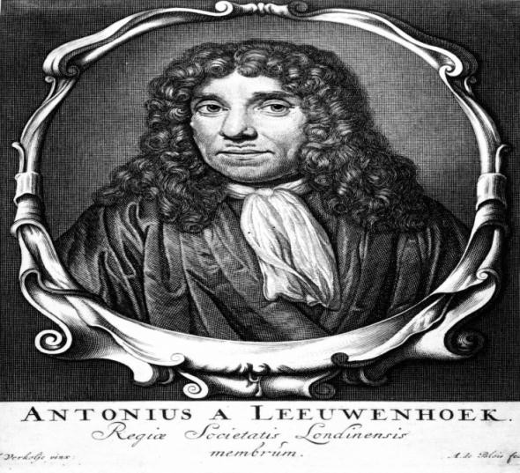
Antony Van Leeuwenhoek(1632-1723)
(Dutch lens maker) Antoine Van Leeuwenhoek—
First observation of live microorganisms by microscope by his own design.
Simple microscope 50X-300X magnification
Made and reported many detailed observations.
Named the observed tiny object as ―animalcules, in 1676.
Laid the foundation of bacteriology and protozoology.
Book – (The secrete of nature)
He also discovered sperm .

Slide 19
Contribution of Leeuwenhoek
He Constructed the first microscope.
The first person to observe microorganism.
He first accurately described the different shape of bacteria.
It is clear from his description that he saw both bacteria and protozoa.
Microorganism were first seen by Leeuwenhoek, and he found many microorganism in material such as water, saliva , and the intestinal contents, of healthy subject, and he recognized them as a living creatures, he call animalcules
He is regarded as Father of Bacteriology‟ and Protozoology‟, because of his contribution to the field of bacteria and protozoa.

Slide 20
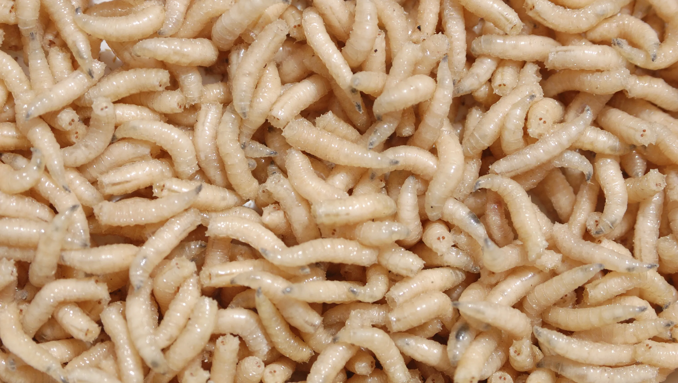
Francesco Redi
Francesco Redi (18 February 1626 –1 March 1697) was an Italian physician , naturalist, biologist and poet.
He is referred to as the "founder of experimental biology, and as the "father of modern parasitology".
From earliest time ,people had believed in spontaneous generation (Abiogenesis) even Aristotle supported this idea.
He was the first person to challenge the theory of spontaneous generation by demonstrating that maggots come from eggs of Flies.

Slide 21
Francesco Redi Experiments
Redi placed meat in three container ,one was uncovered, a second was covered with paper, and the third was a fine gauze that would exclude flies.
Flies laid their eggs on the uncovered meat and maggots developed.
The other two pieces of meat did not produce maggots spontaneously.
However ,flies were attracted to the gauze-covered container and laid their eggs on the gauze ,these eggs produced maggots, hence spontaneous generation was disapproved.

Slide 22


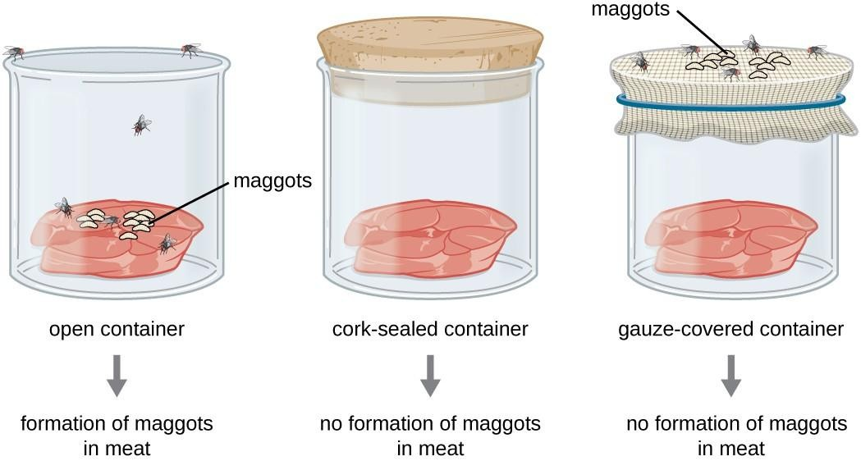
Francesco Redi Experiments

Slide 23
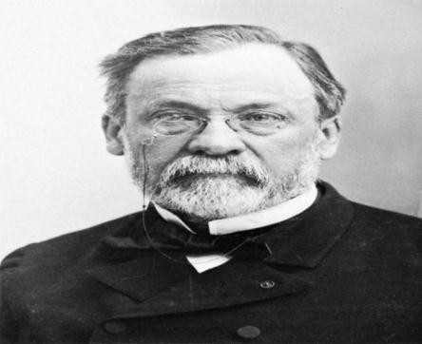
Louis Pasteur(1822-1895)
He was a French Biochemist, (1822-1895).
He is regarded as „Father of modern Microbiology and modern Immunology‟.
He Proposed the „Theory of Germ Disease‟, where diseases of plants, viruses, animals and human beings are caused by pathogenic microbes.
He disproved the theory of abiogenesis by conducting „Swan neck flask experiment‟.
Proved that all forms of life even microbes arose only from their likes (disapproved spontaneous generation).

Slide 24

Contribution of Louis Pasteur
He coined the term ,microbiology, and discovered the presence of bacteria in the air and classified the bacteria into aerobic and anaerobic forms.
Established that fermentation (chemical break down of Substance by microorganism )was the result of microbial activity.
He developed technique to prevent souring of milk and spoilage of wine. His technique is now called Pasteurization technique.
Process of attenuation discovered and production of attenuated vaccine.
He first isolated bacteria causing cholera (Vibrio cholera).
Various antiseptic technique.

Slide 25


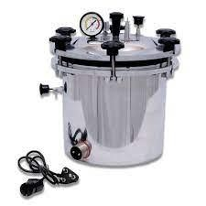
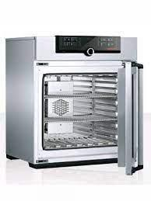
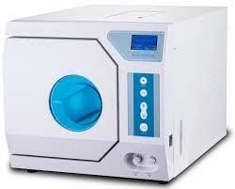
Develop Sterilization Technique Hot air oven Autoclave Steam Sterilizer

Slide 26
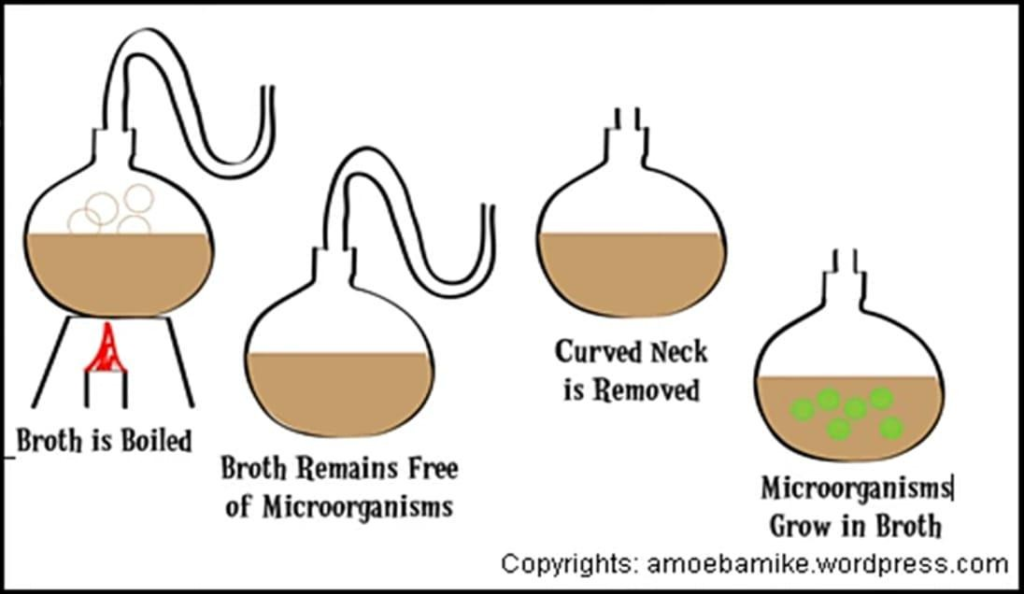
Pasteur's Experiment Swan-necked flask experiment

Slide 27

Contribution of Robert Koch
He was a German microbiologist (1843-1910).
His contribution to the field of microbiology and medical science is the most valuable one.
He developed for the first time staining technique to stain the bacteria with acidic or basic stain.
He developed for the first time culture technique to culture the bacteria in the laboratory.
He discovered bacteria caused tuberculosis of man.
Anthrax (1876).

Slide 28
Contribution of Robert Koch
He Isolated and identified different kinds of bacteria from various sample.
He was awarded Nobel Prize of medicine in 1905, formulating principles regarding diseases. These are now called “Koch Postulates”
He proved theory of germ diseases of Louis Pasteur by conducting investigative experiment.
According to Koch's postulates, a microorganism can be accepted as the causative agent of an infectious disease only if the following conditions are satisfied.

Slide 29
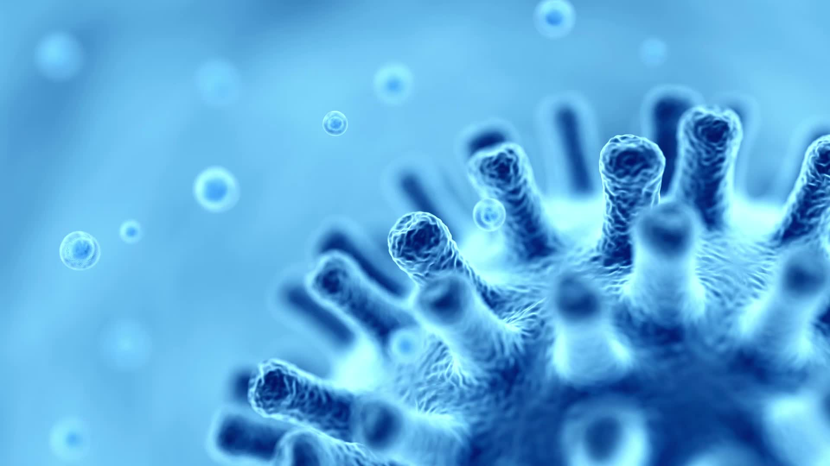
Koch Postulates (Criteria)
Presence: The microorganism must be found in all diseased individuals but not in healthy ones.
Isolation: The microorganism must be isolated and grown in pure culture from the diseased host.
Causation: The cultured microorganism must cause the same disease when introduced into a healthy organism.
Re-isolation: The microorganism must be re-isolated from the experimentally infected organism and match the original.

Slide 30


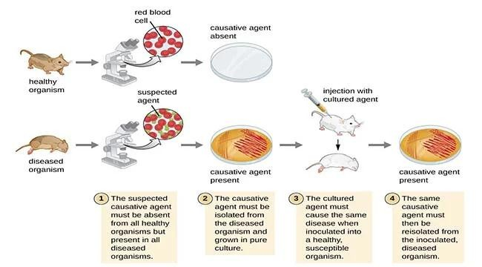
Koch Postulates

Slide 31


Importance of Microbiology in Nursing
For Nursing student ,microbiology is a vital subject. Nurses are involved in managing all aspects of patient’s health and infection control in the hospitals. Nurse must know microbiology knowledge to take care of patient and to protect environment, patients and oneself from pathogenic microorganisms.
For Nursing microbiology is the application of the knowledge of medical microbiology at the bedside of patients during nursing care.
Nurse learn how the disease-producing organisms enter the body, and how they spread from person to person.

Slide 32
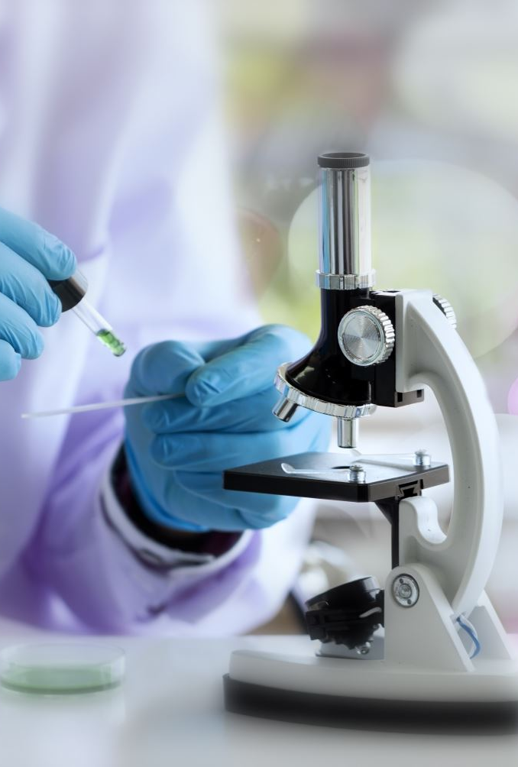
Conti…
The study of microbiology help the nurse in many ways.
Nurse will understand the principles of disinfection and effect of drugs on microorganisms.
Nurse recognize the importance of proper collection of specimens for bacteriological examination in the laboratory and understand the meaning of reports received from the laboratory.
In addition, Nurse understands how sera and vaccines used in the treatment and prevention of diseases are prepared and their effects on the human body.

Slide 33
Role of Nurses in Different Units
To Prevent spread of infection
To Maintain sterile field
To Collect specimen
To Implement immunization schedule in hospital
Implementation of microbiology in Nursing: Role of nurses in different units.
Burns unit / Operation theatres
Obstetric units / Intensive care nursery
To Dispose of biomedical waste

Slide 34
To Prevent Spread of Infection
Infections propagate in different ways, and nurses should be aware of this.
As well as contact (touch),air (airborne),droplets (sneezing, coughing), contaminated food and drink (foodborne),sexual contact and infected blood transfusion.
Nurses can utilize this knowledge to identify specialized infection control measures.
By understanding how disease-causing organism enter ,exit and spread from one individual to another, nurses can take special measures to prevent infections within the hospital and community.

Slide 35
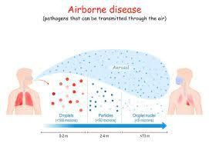
Conti…
Example of such diseases include Cholera ( Vibrio Cholera, common cold (Rhinoviruses, Coronaviruses, adenoviruses ), chicken pox (varicella-zoster virus) and TB(Mycobacterium tuberculosis)
When a person suffering from common cold sneezes, fine droplets of moisture, carrying thousands of viruses are spread in the air. The virus may enter the body of healthy person while breathing.

Slide 36

To Maintain Sterile field
In hospital ,sterile fields must be established and maintained using microbiology techniques ,which a nurse needs to be familiar with.
Nurses must understand how to create and maintain sterile fields in operating rooms, for example ,in order to prevent infection following surgery.
Remember to wash your hand before and after surgeries .
Nurses benefit from hand washing by minimizing the number of microorganism on their hands, thereby reducing their risk of hospital – acquired infection.
The nurses can also use microbiology knowledge to use sterile equipment which is necessary for invasive procedures.
Sterilization process need to be understood by nurses.

Slide 37
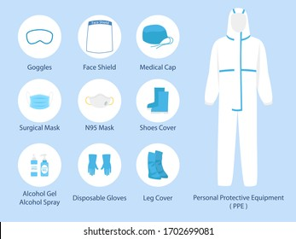
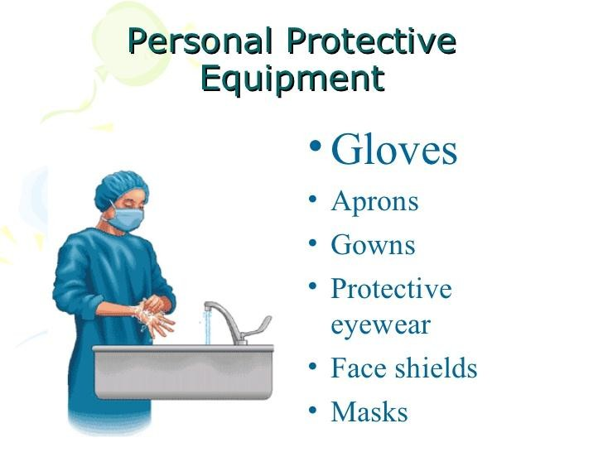
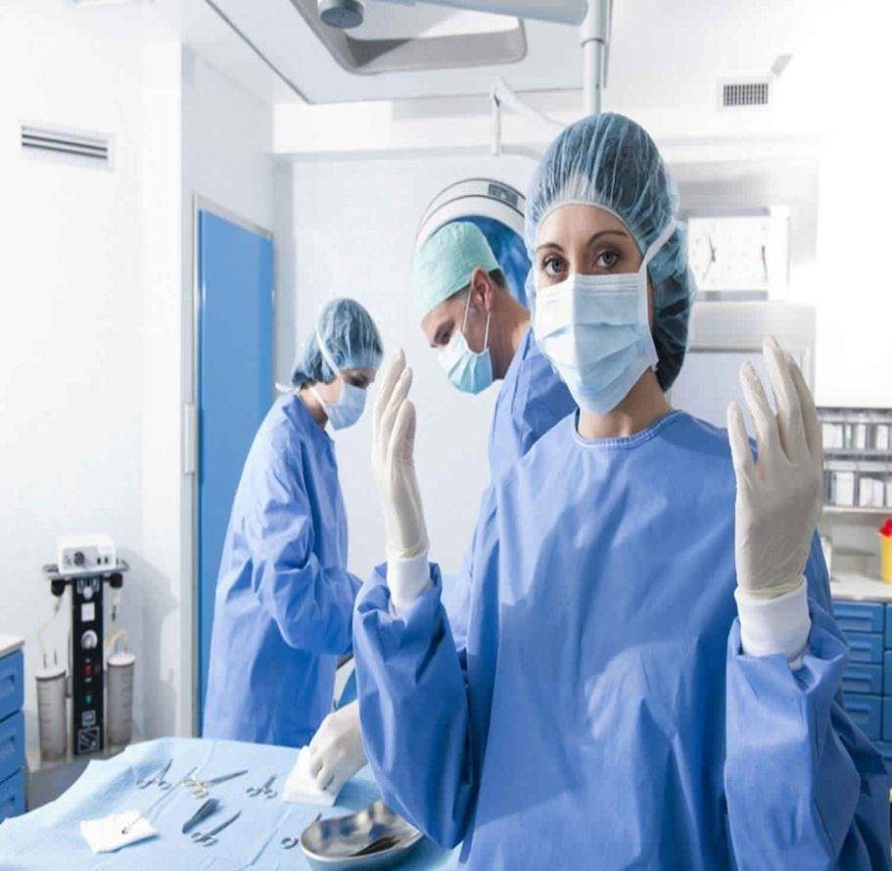
To Maintain Sterile field
The Nurses can also use microbiology knowledge to use sterile equipment which is necessary for invasive procedures.

Slide 38
To Collect Specimens
Nursing practitioners must understand the importance of properly collecting specimen for bacteriological testing to achieve reliable results.
He/she must be familiar with a variety of infectious diseases and their mood of infection.
A Nurse must know how importance it to collect specimens correctly for bacteriological analysis to obtain reliable results.
To identify the organism responsible for an infection ,it is necessary to collect a clinical specimen from the appropriate site of infection.

Slide 39
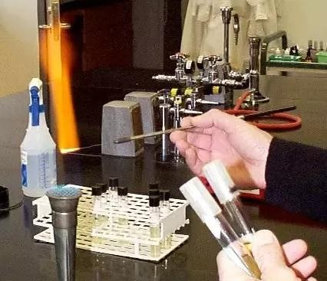
Conti…
A Nurse must know how importance it to collect specimens correctly for bacteriological analysis in order to obtain reliable results.

Slide 40
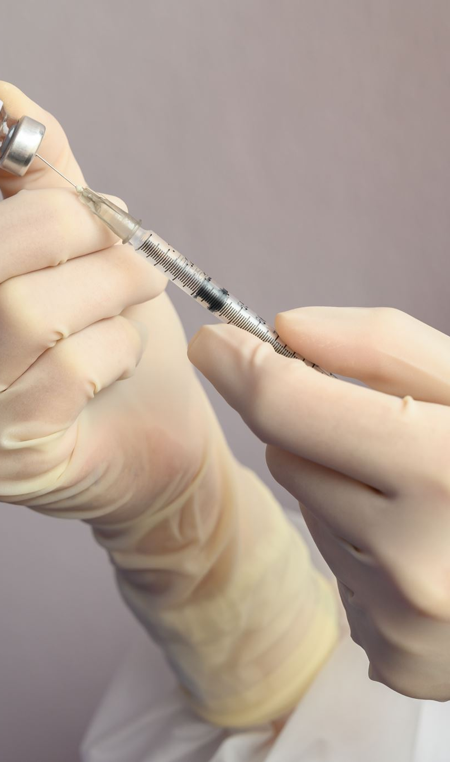
To Implement Immunization Schedule in Hospital
In Addition to immunization patients against diseases such as diphtheria and MMR,nurses also play an important role in preventing other diseases.
A Nurse should be knowledgeable about vaccine schedules and how vaccines are transported from production to administration via a cold chain.
The Nurse who know immunology is well prepared for vaccines and can use the cold chain effectively for vaccination and vaccine protection.

Slide 41
Role of Nurses in Different Units
Some of the areas discussed in health care setting relate to microbiology role as a nursing specialty.
Patients with contagious or infectious diseases are hospitalized in contagious or infectious wards.
For example, the rabies wards or the gastroenteritis wards ,and the nurse take great care of them by taking precautions to prevent the infection from spreading others.
The Nurse employ aseptic procedure while caring for patients.

Slide 42
Conti…
Burns’ unit: Initially a burn wound is sterile but within a short time the microorganisms starts colonizing in it. A nurse takes special care to prevent the wound from becoming infected when caring for such type of patient. She follows not only aseptic techniques but also uses sterile equipment while looking after such patients.
Operation theatres: Before operation, it is duty of a nurse to ensure that the atmosphere of the operation theatre (OT) is free of microorganisms. It is done by the process of fumigation of the operation theatre from time to time. Nurse should assure that all procedures on a patient are done under sterile conditions. Swabs are cultured from a variety of locations throughout the operation theatre to determine a theaters sterility.it is imperative that procedure on a patient is conducted under sterile conditions.

Slide 43
Conti…
Obstetric units: The wound infection of birth canal after childbirth or abortion is a major cause of maternal mortality rate. The reason is that the infection spreads and causes peritonitis or phlebitis. The nurse can play a role during antenatal care(before delivery),help during delivery or after giving birth for 6 weeks period called puerperium.
Intensive care nursery: In intensive care nurseries especially, experienced staff is employed who has good knowledge of incubators, gastrostomy feeding, exchange transfusion, respirator and umbilical catheters which are necessary for infants. Nurses must keep a check to maintain sterile atmosphere in these intensive care nurseries.

Slide 44
To Dispose of Biomedical Waste
There must be an appropriate way to dispose of biomedical waste, which is based upon microbiology principles.
A Nurse should be familiar with the process used in hospital to create and maintain sterile fields based on microbiological expertise.
Effective disposal of sewage and waste.
With microbiology forming the foundation of professional nursing, the nurse has an increasing responsibility to practice and teach hygienic measures both in the care and prevention of disease.
Proper biomedical waste dispose based on microbiology principle is required.

Slide 45
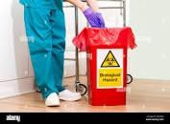
Conti...
Biomedical waste must be disposed of. If biomedical waste is not properly disposed of, it may result in the outbreak of a terrible disease .

Slide 46





Any Question

Slide 47


